Slide 1
Embedded LDPC Codes
Hanno Jacobs
17000042

Slide 2
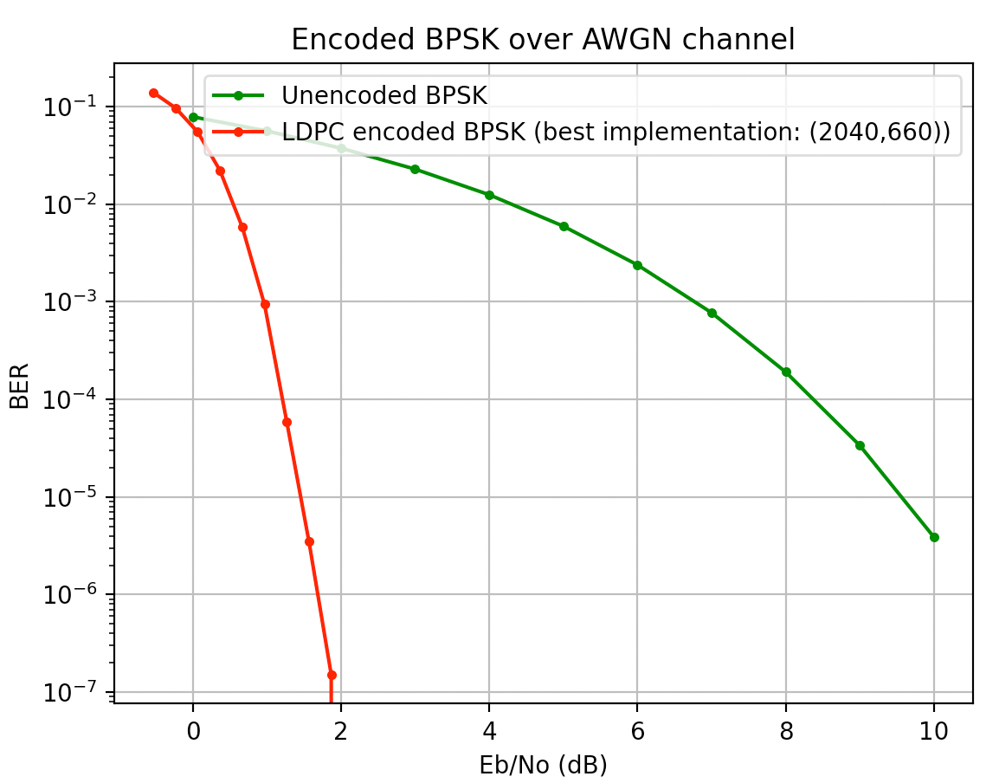
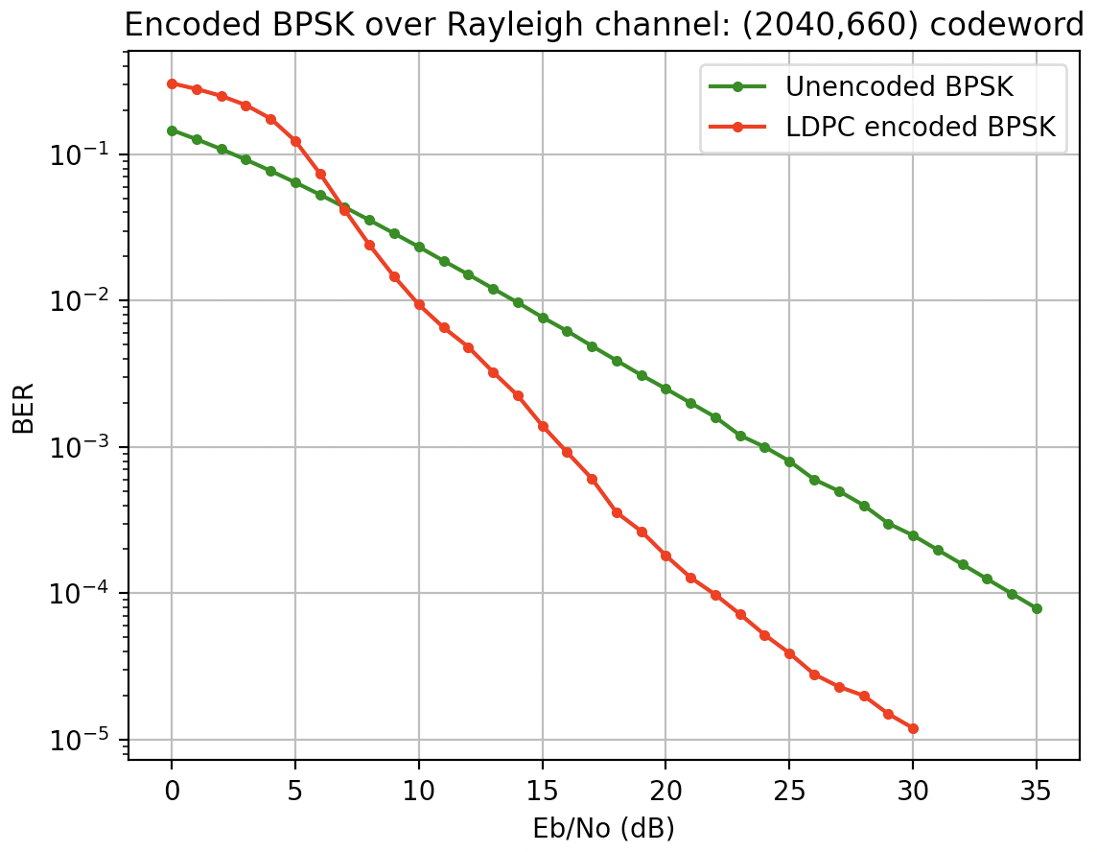
Simulation results for AWGN channel and Rayleigh flat-fading channel decoders:

Slide 3
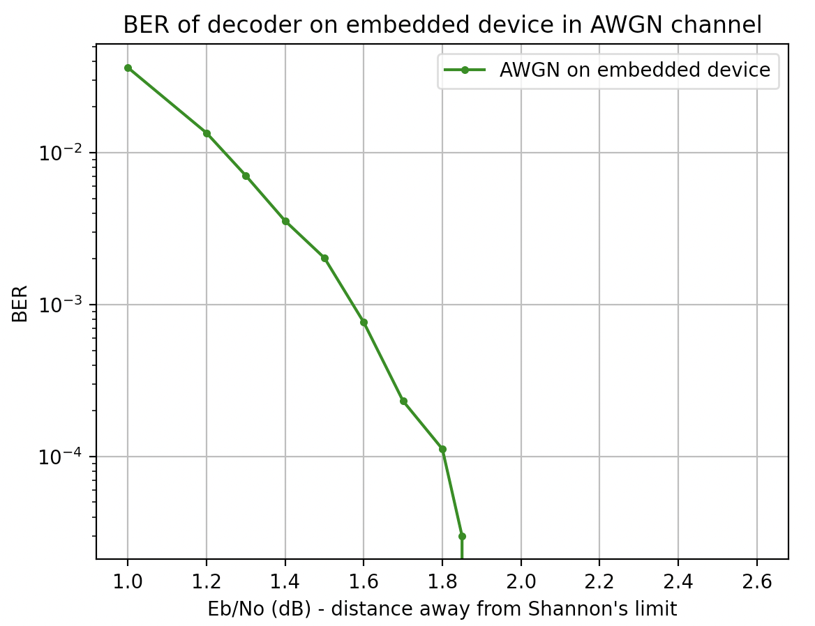
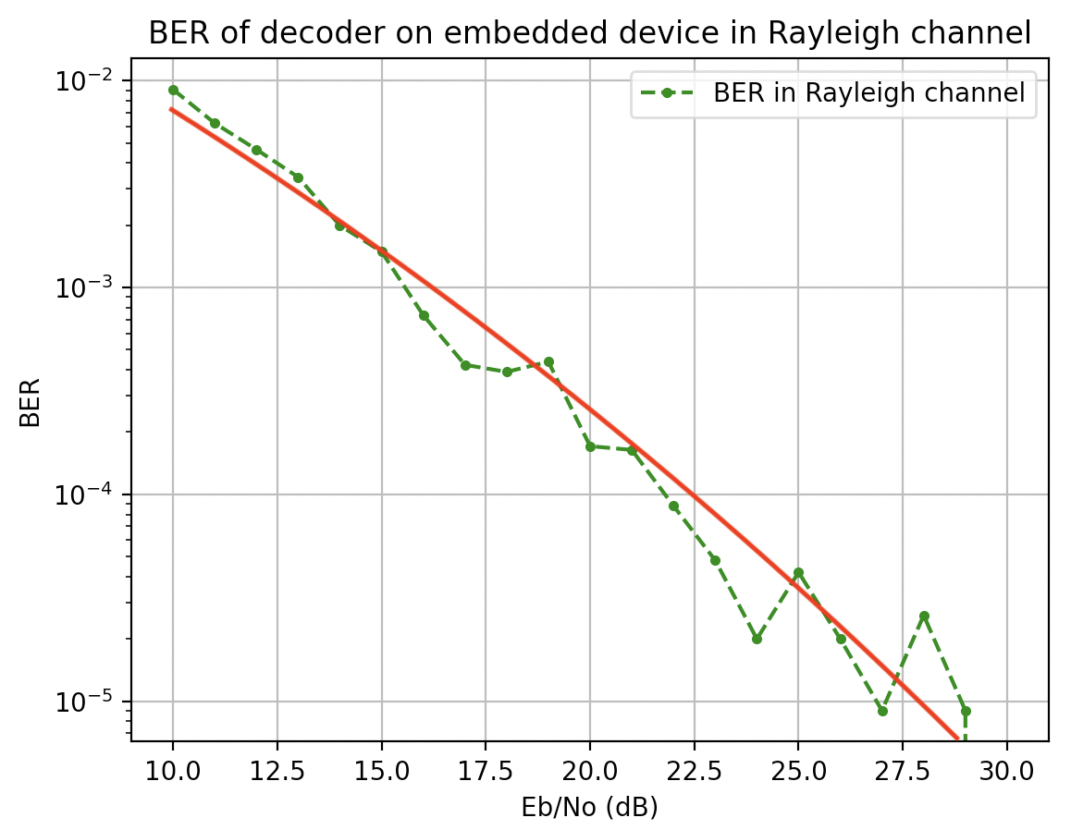
Embedded results for AWGN channel and Rayleigh flat-fading channel decoders:

Slide 4
Run time results:
AWGN channel decoder: 0.25 seconds/codeword
Rayleigh channel decoder: 0.11 seconds/codeword
All tests are done for code length of 2040 bits at a rate of 0.323 (according to specifications)

Slide 5
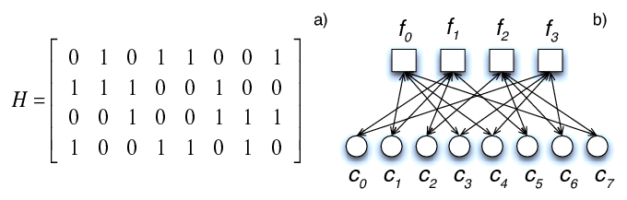
What is LDPC?
Works on a parity check matrix
Determines which message bits are protected by which parity check bits
Low Density of connections
Not every message bit is protected by every check bit
Goal: very high noise communication
Trade off speed for high noise communication

Slide 6
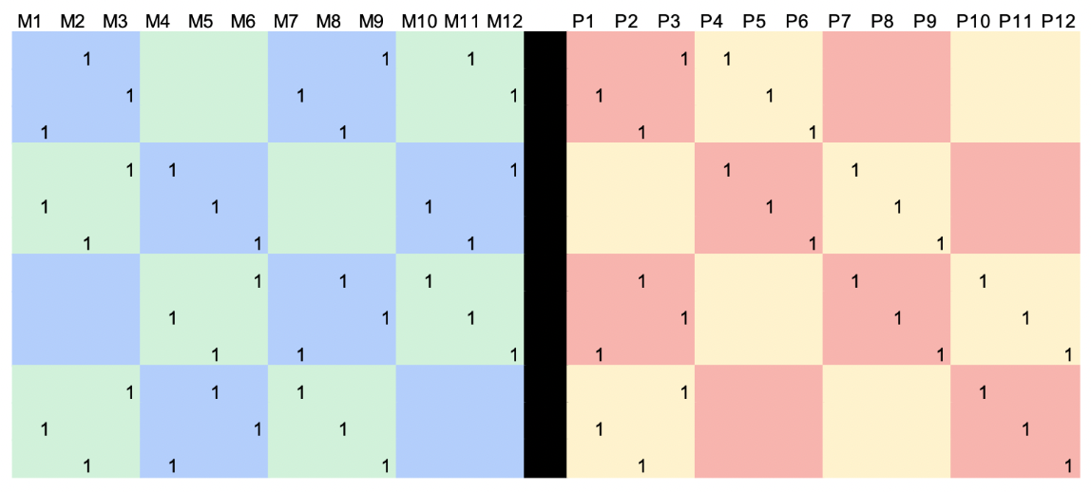
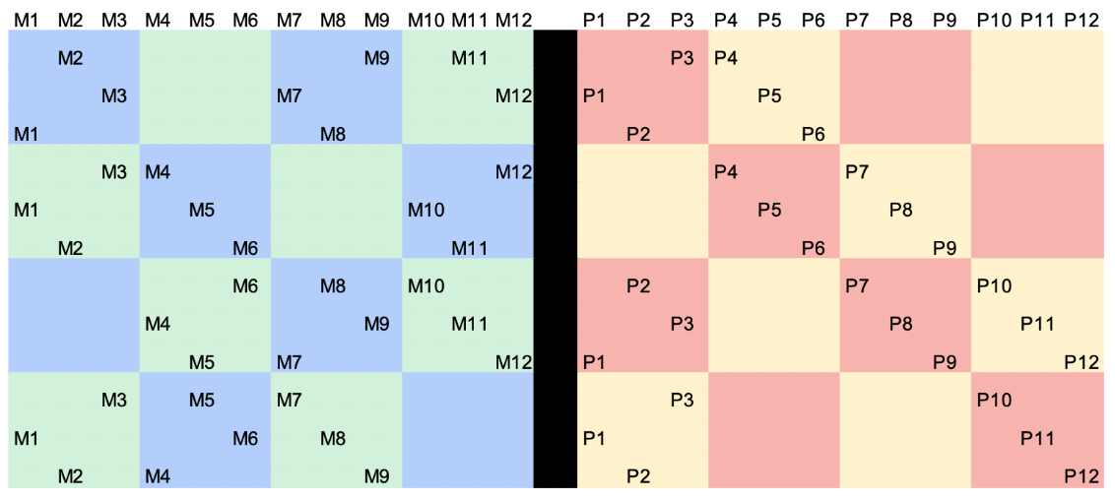
Parity check matrix encoding:

Slide 7
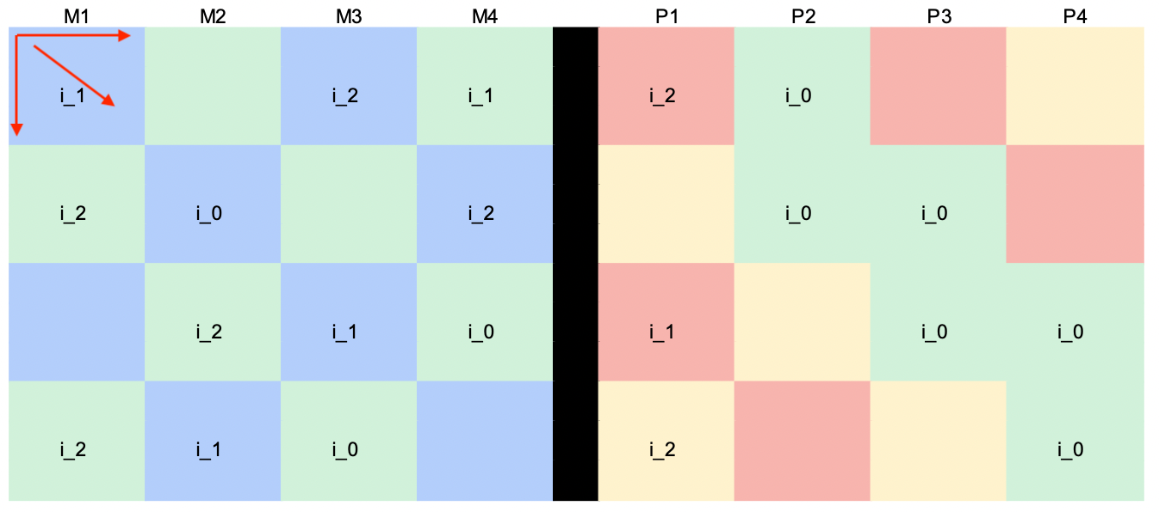
Base-matrix expansion
Expanding base matrices in 2-dimensions
Expansion factor Zc
Cyclically shifted identity matrix
Base matrices allow
Skipping over “zeros”
Variable code-rates
In-place operations
Save on memory
Save on run-time

Slide 8
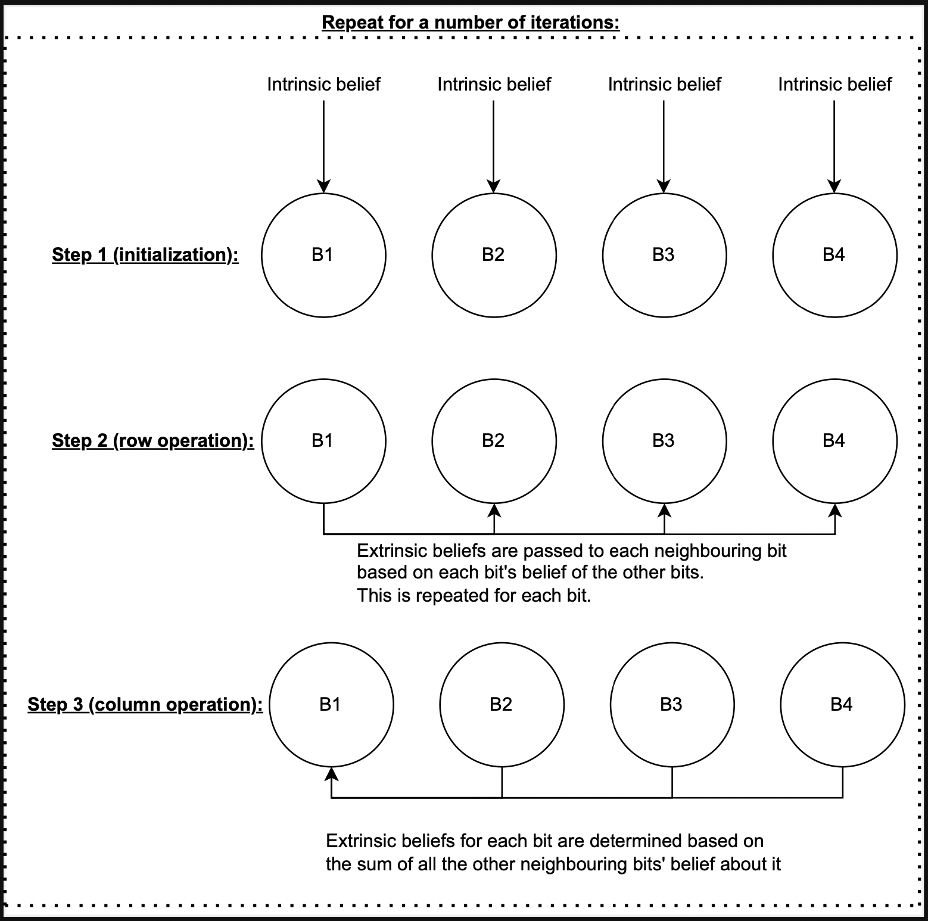
Decoding using belief propagation
Using float values obtained at receiver
Each bit in a check node “communicates” its belief of each other bit with the other bits in the check node

Slide 9
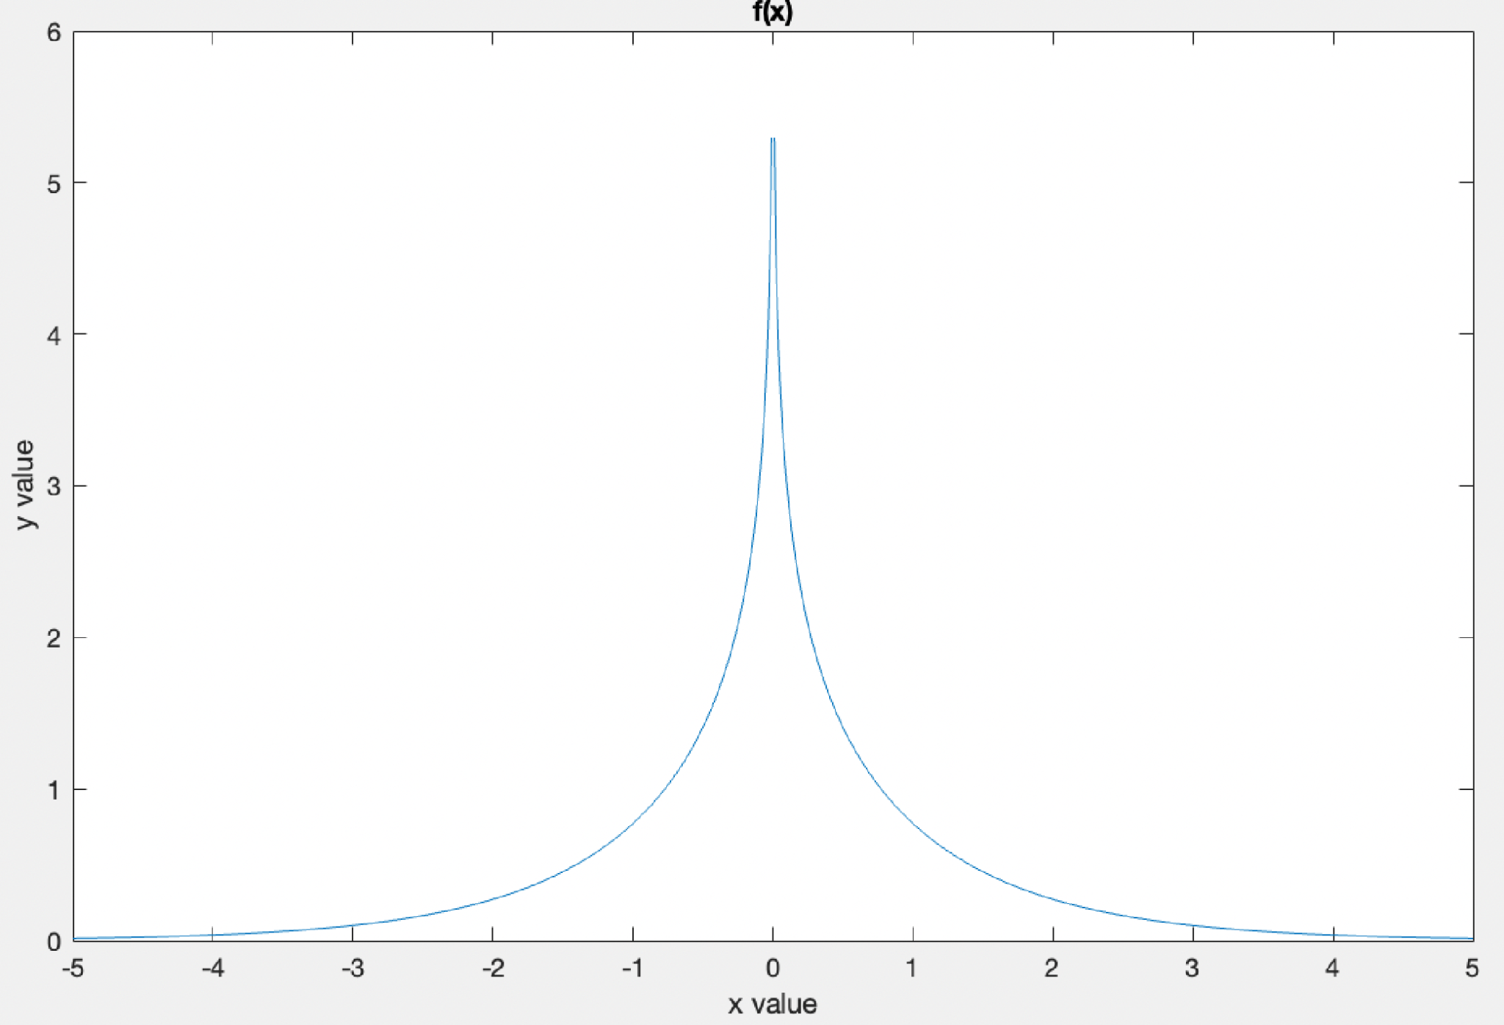
Minsum approximation
The communication of bits in rows simplifies to addition of each float value sent through f(x) = ln(tanh(x))
Therefore, the smallest “x” value dominates the equation
Minsum approximation:
All in row = min1
Smallest value = min2

Slide 10
Decoder steps:
Run min-sum algorithm on each row individually
This facilitates the communication of bits in check node
At end of rows add up all the values in columns and update the beliefs of the message
Repeat for a number of iterations

Slide 11
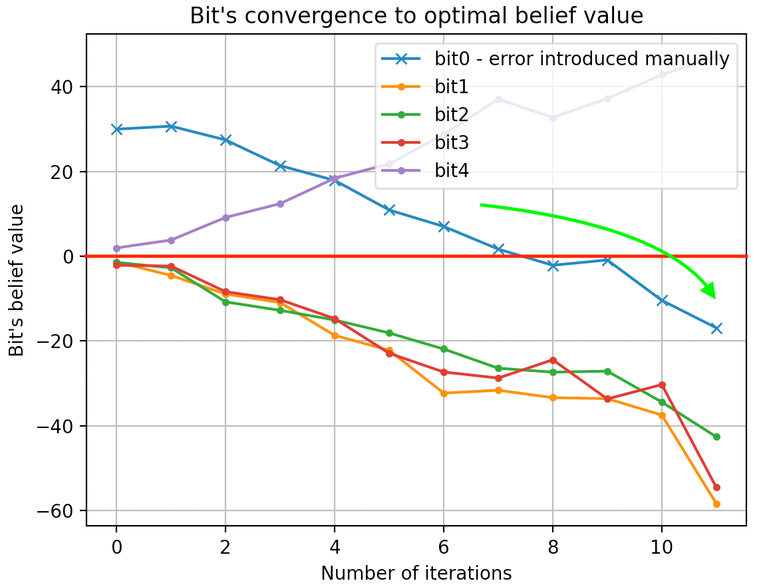
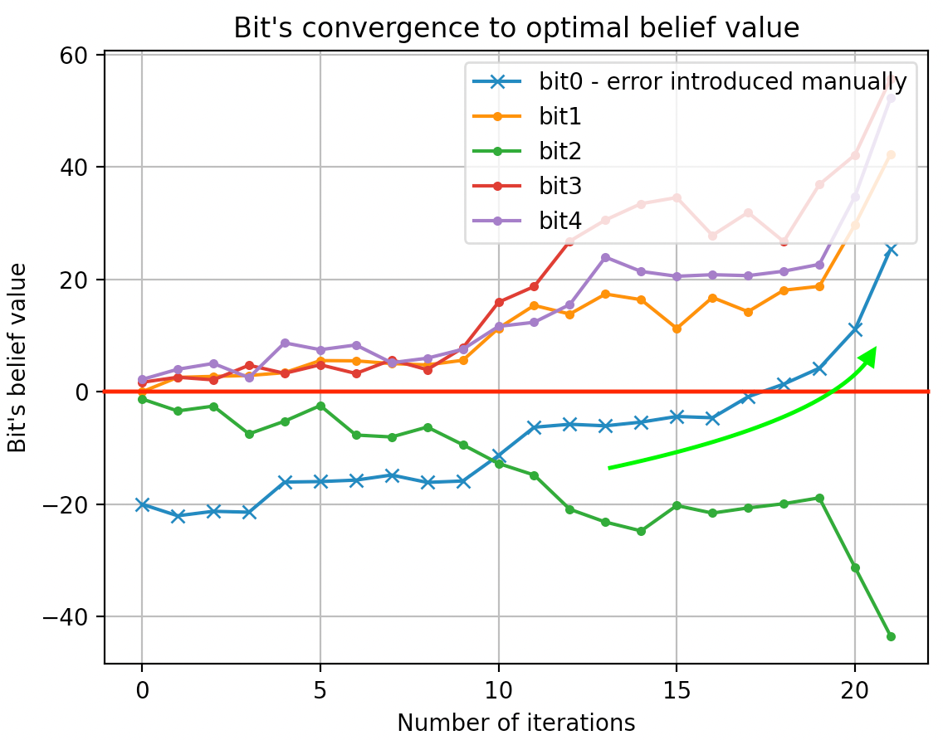
Bit convergence:

Slide 12
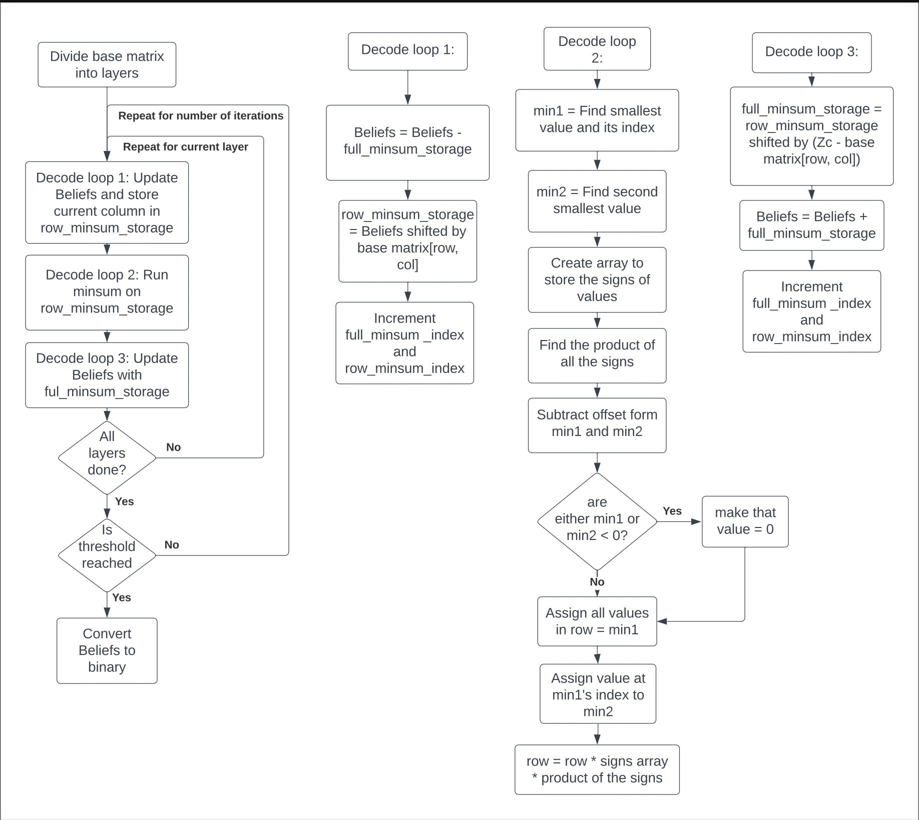
Optimized decoder algorithm

Slide 13
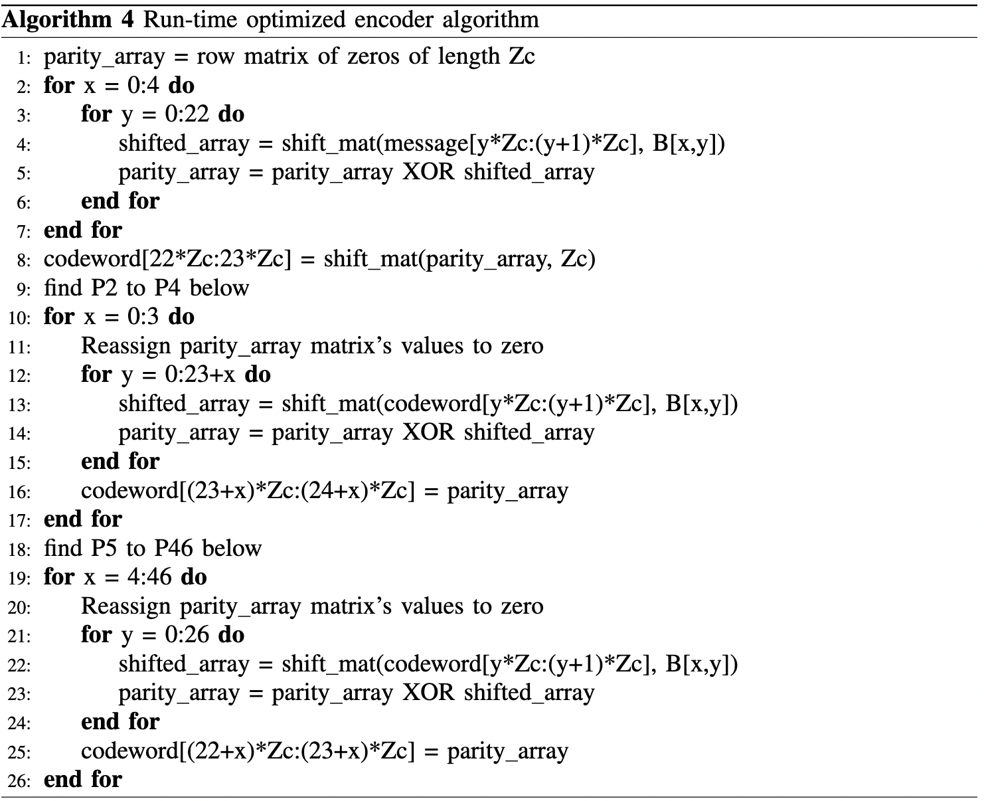
Optimized encoder algorithm

Slide 14
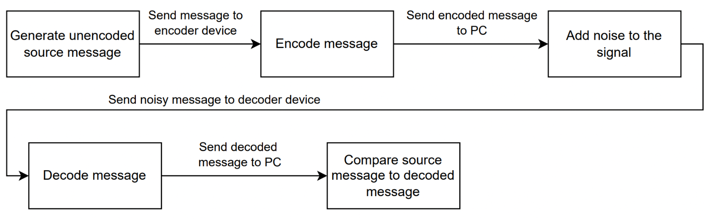
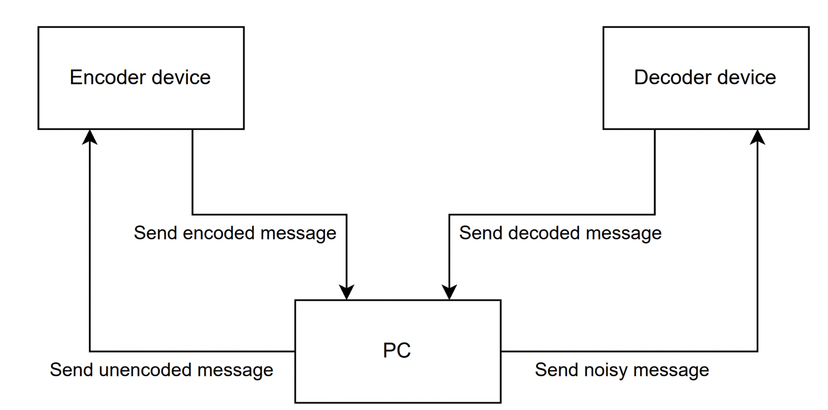
System overview:

Slide 15
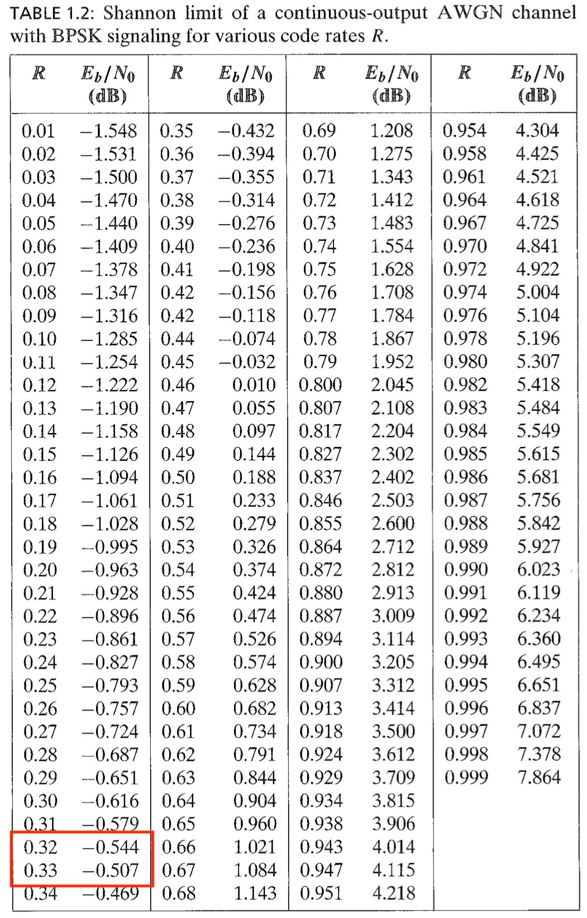
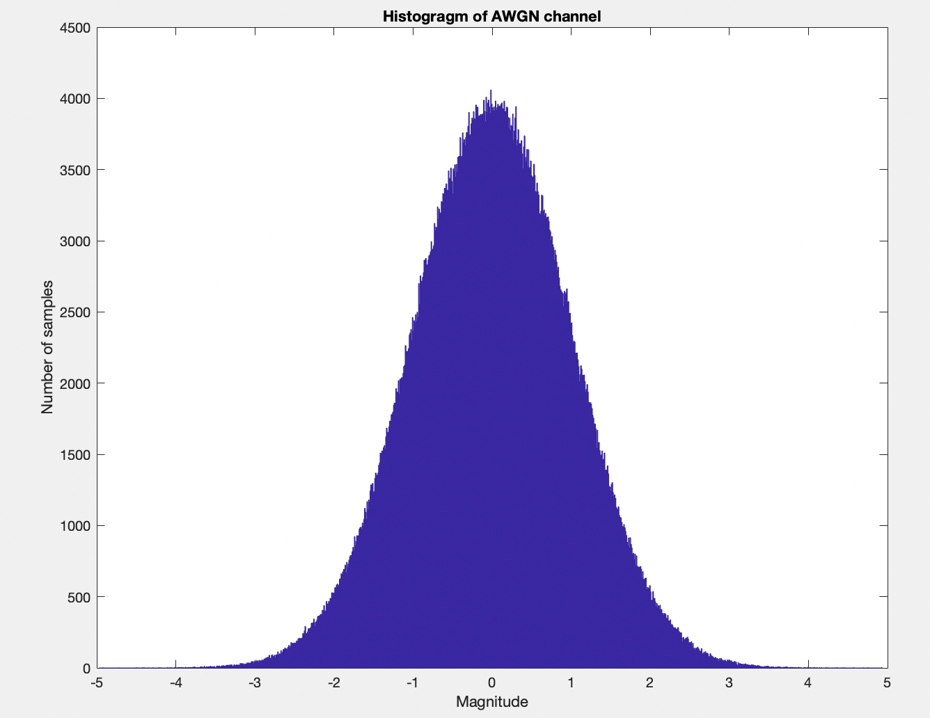
AWGN channel model
Based on normal distribution
Used as common benchmark
Shannon’s limit is defined for different code rates

Slide 16
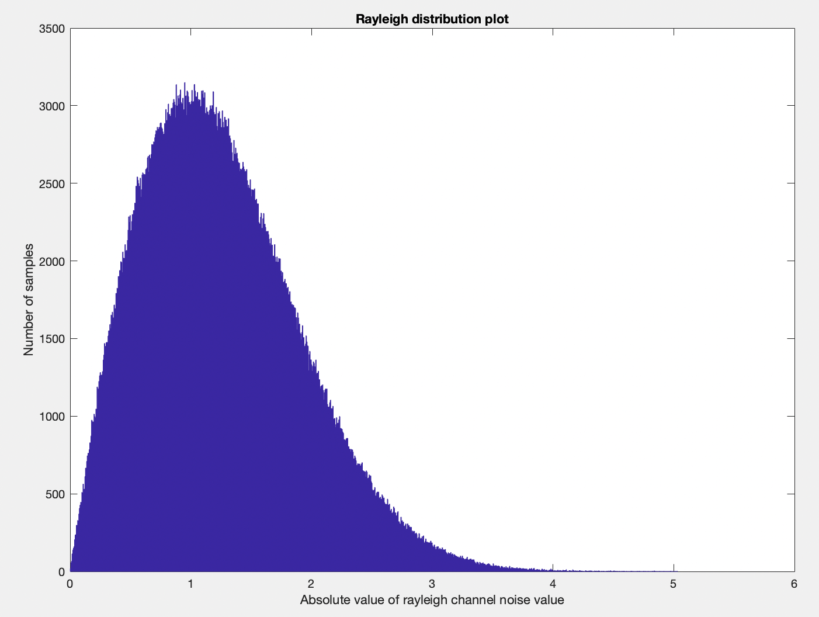
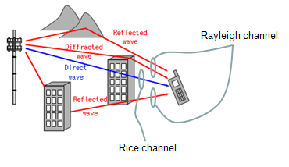
Rayleigh flat-fading channel model
Models more real-world channel
Bouncing off of objects in the vicinity
No true line-of-site
Rayleigh Fading Channel (Image Courtesy: ShareTechNote)

